Slide 1
Erin’s Law Presentation
LGS - K-3rd grade

Slide 2

What today is about
Every year, we learn what to do in case of a tornado, fire or an intruder.
It’s also important to also know how to recognize and keep yourself and others safe from abuse.
This is a difficult and serious topic. Please use you best listening skills.

Slide 3

Erin Merryn
Erin’s Law

Slide 4

Types of Abuse
Physical
Emotional
Neglect
Sexual

Slide 5
“Protect Yourself Rules” Intro
Protect Yourself Rules keep you safe!
Barbara Sinatra Center for Abused children Video 2:30

Slide 6
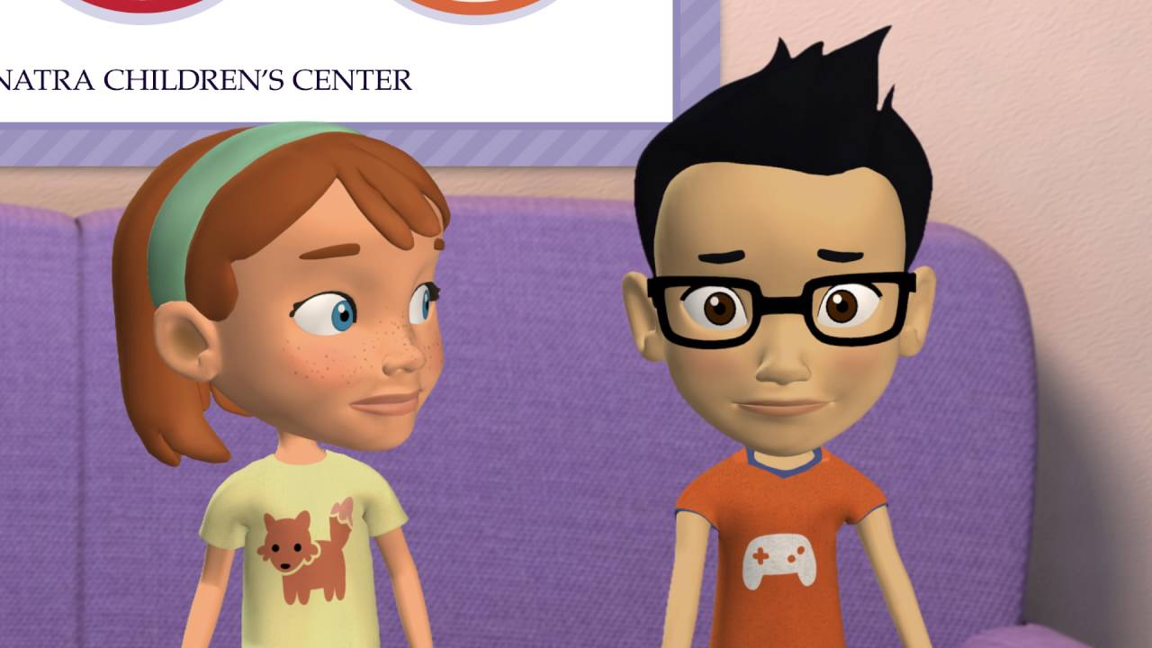

Slide 7
“Protect Yourself Rules”
Protect Yourself Rules keep you safe!

Slide 8
“Safe Touch, Unsafe Touch”
Barbara Sinatra Center for Abused children Video 2:07

Slide 9


Slide 10
Safe Touch
Safe touches make us feel good.
Hugs from family members
High fives from friends
Holding mom or dad’s hand

Slide 11
Private Parts
Your private parts are the parts of your body covered by a bathing suit.
No one has a right to touch your private parts or touch you in any way that makes you feel uncomfortable.
No one should ask you to touch their private parts.
Sometimes when parents take a child to the doctor, they may need to examine private parts.
A baby may need their diaper changed or a young child may need help wiping.

Slide 12
Good Secretes
Good Secretes are safe and fun!
A surprise party
A Christmas present
The family is going somewhere special for a surprise
If someone is having a baby boy or a baby girl

Slide 13
Bad Secretes
Secretes that are not safe and hurt people
* If someone gives you an unsafe touch, they might tell you to keep it a secrete
* You always ned to tell a grown up about unsafe touches!
* Keep telling until someone helps you

Slide 14
“Shout, Run, Tell”
Protect Yourself Rule
Barbara Sinatra Center for Abused children Video 1:46

Slide 15
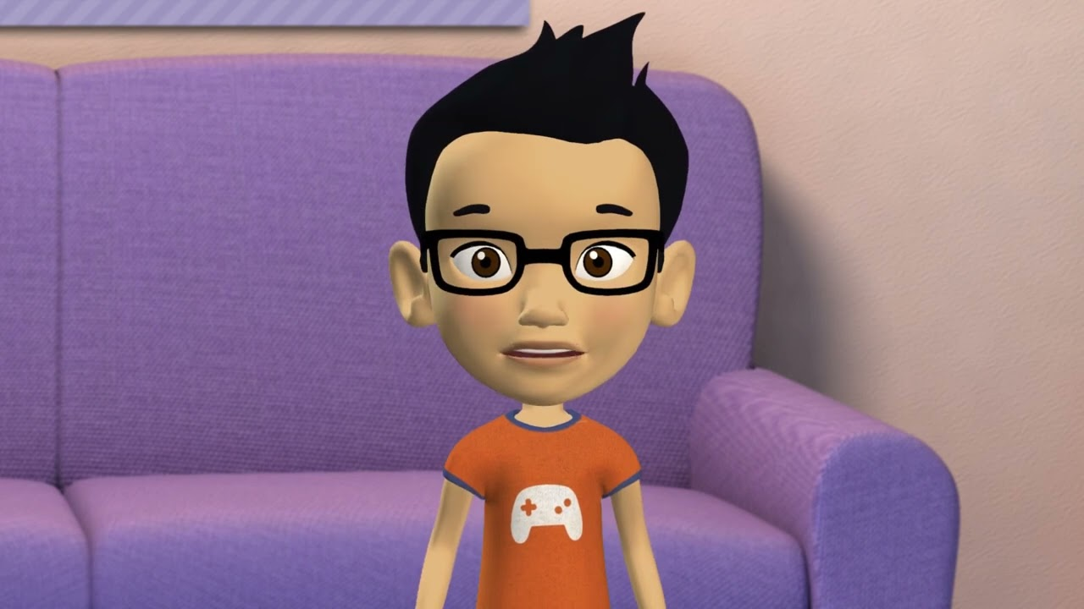

Slide 16
“Shout, Run, Tell”
Protect Yourself Rule, “Shout, Run, Tell”!
No one has a right to touch you in a way that makes you feel unsafe.
Sometimes you may be too scared to shout or run.
Tell an adult right away!

Slide 17
“A Neighbor”
It does not matter who it is. If some touches you on a private part of your body, you have to shout, run and tell.
Barbara Sinatra Center for Abused children Video 3:49

Slide 18
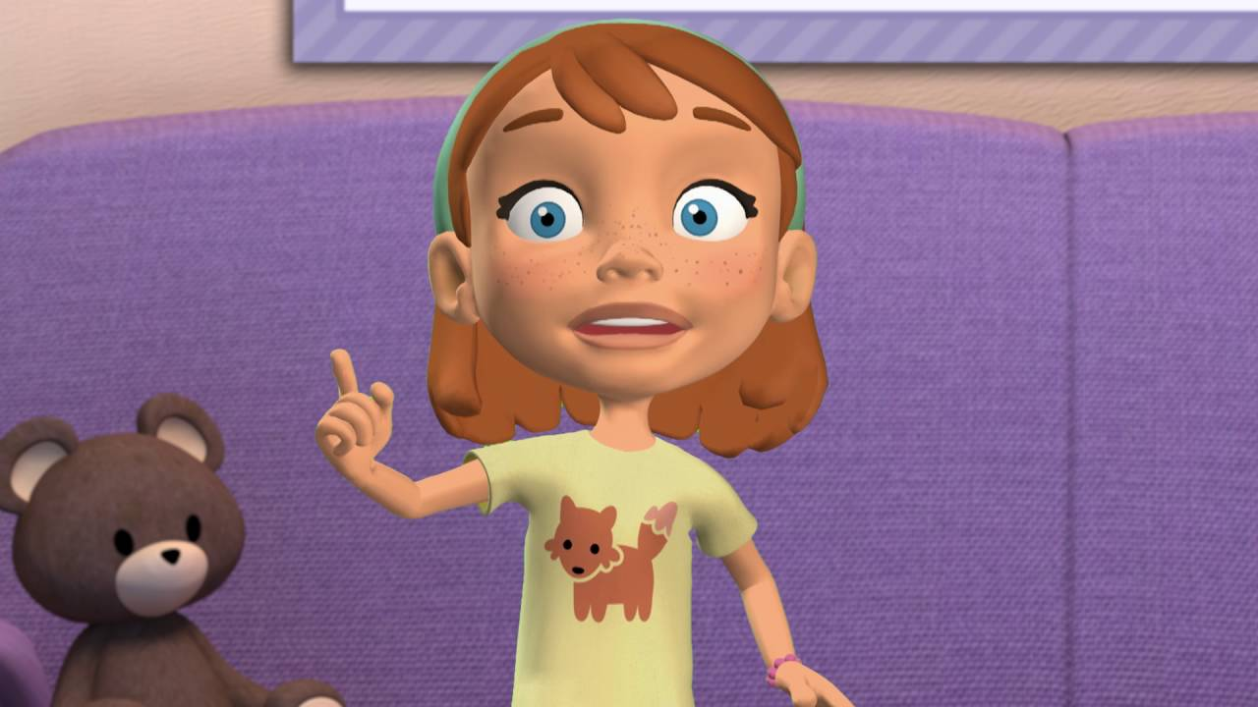

Slide 19
It doesn’t matter who it is, tell!

Slide 20
Trusted Adults
Parents
Other family members
Your friend’s parents
Teachers, social worker, etc.
Coaches
Church leaders
Police and other emergency responders

Slide 21

Internet Safety
Do not give out your passwords or log into a friend’s device.
Make your settings private.
Be mindful of what your are posting and texting. It will be out there FOREVER!
If you are sent something that makes you feel uncomfortable, speak up.

Slide 22
Any Questions?
Please fill out your card
Name & Grade
Check a box:
I do not have any questions
I have a question, but it is nothing urgent
I have an important question and/or need to chat ASAP

Slide 23
Talk with your parents about the Protect Yourself Rules you learned today!

